Slide 1
Building the Perfect Beach Playlist
BSAN 360 | Akshaj Nair | Github
December 12th 2025

Slide 2

Premise
I go to the beach with my friends all the time and it is always a fight to pick who gets to control the speaker.
Last summer I was tired of the bickering, and we decided to make a group playlist.
I noticed a lot of songs I liked and enjoyed, but also quite a few I did not know.
So I began to think –what about a song makes it a “beach song”?
My Friends & I

Slide 3




Exploring The Dataset
The dataset came directly from a Spotify export
https://exportify.net – turned the playlist into a CSV
CSV file comes clean and organized with Tracks, Albums, Artists, and labels for each row
Includes descriptive analytics for each track (danceability, acousticness, tempo, key, loudness, valence)
Three people added songs to the playlist
126 Rows
24 Columns
96 Different Artists
12 Audio Features

Slide 4
Abridged Data Dictionary
Larger List Can Be Found - https://www.kaggle.com/datasets/rohansharmads/spotify-data-dictionary
danceability: Danceability describes how suitable a track is for dancing based on a combination of musical elements including tempo, rhythm stability, beat strength, and overall regularity.
energy: Energy is a measure from 0.0 to 1.0 and represents a perceptual measure of intensity and activity.
key: The key the track is in. Integers map to pitches using standard Pitch Class notation.
loudness: The overall loudness of a track in decibels (dB)
mode: Mode indicates the modality (major or minor) of a track, the type of scale from which its melodic content is derived.
speechiness: Speechiness detects the presence of spoken words in a track.
acousticness: A confidence measure from 0.0 to 1.0 of whether the track is acoustic.
instrumentalness: Predicts whether a track contains no vocals. "Ooh" and "aah" sounds are treated as instrumental in this context
liveness: Detects the presence of an audience in the recording. Higher liveness values represent an increased probability that the track was performed live.
valence: A measure from 0.0 to 1.0 describing the musical positiveness conveyed by a track.
tempo: The overall estimated tempo of a track in beats per minute (BPM).
time_signature: An estimated time signature.

Slide 5



Key Questions Asked
What traits about a certain song fits the criteria to be a Beach Song for the playlist?
Is there a certain decade of music (70's, 80's, 90's, 2000's, etc)? I can use the release date column to see what comes up the most often in the playlist.
Is there an overall tempo that needs to be present for us to relax on the beach unbothered or does it vary?
Mac Demarco, Frank Ocean, Tame Impala

Slide 6
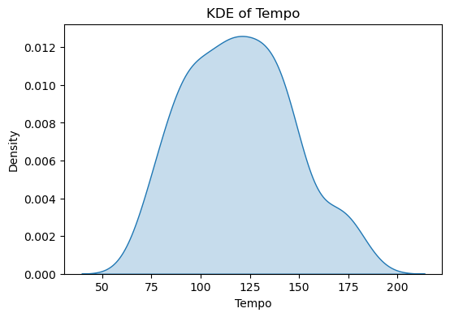
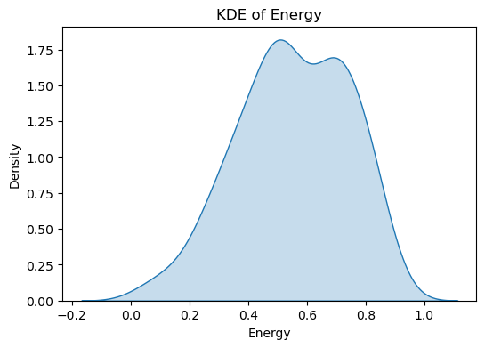
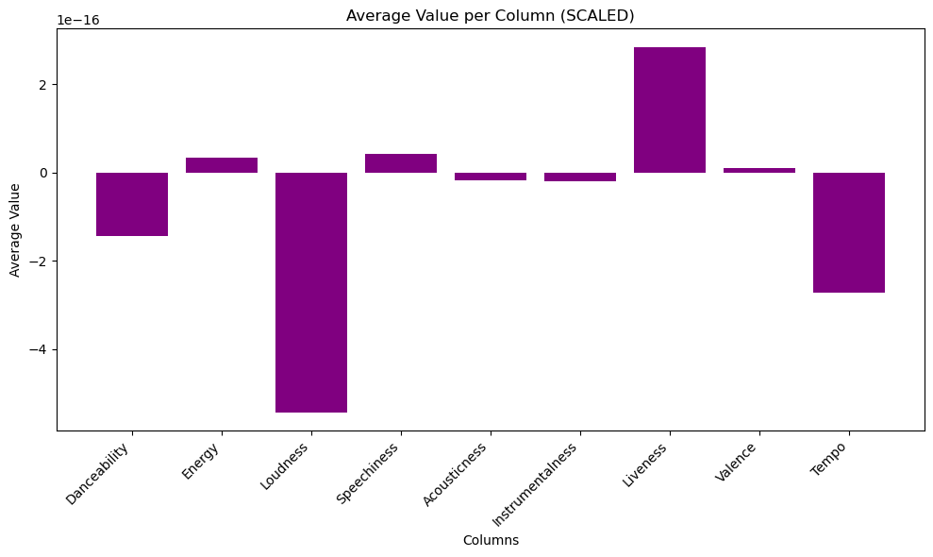
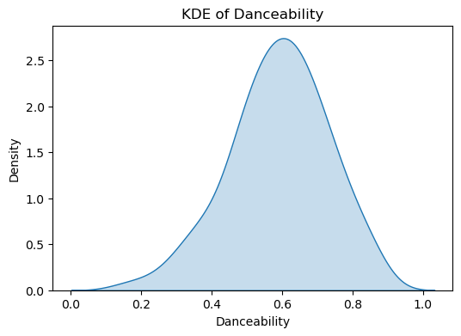
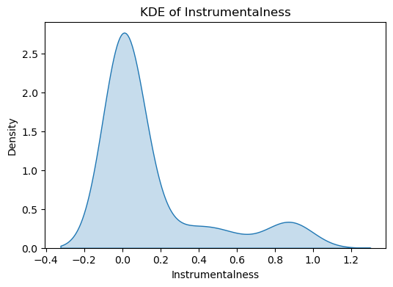
Exploratory Data Analysis

Slide 7

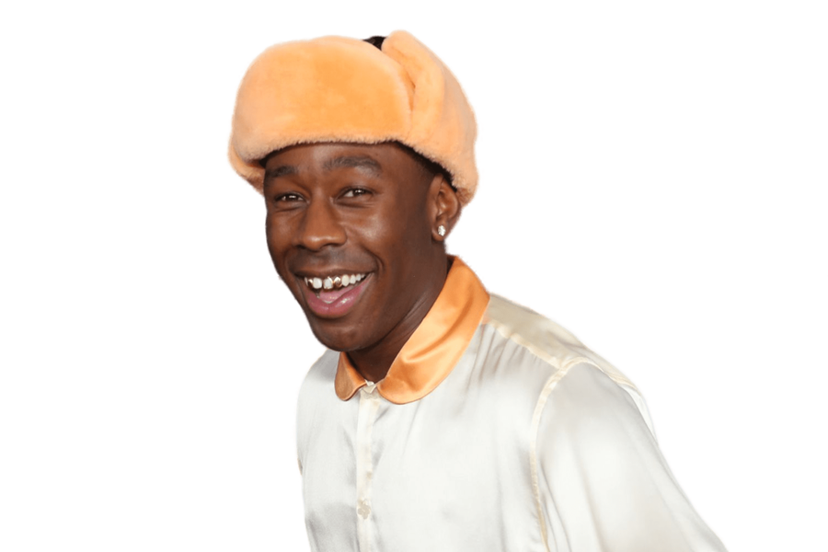
The Process
This is a classification task with potential to better understand how to build a model to predict what songs “make the cut.”
Principal Component Analysis (PCA)
Since there are so many columns that depict why certain songs are apart of the playlist, before any further analysis I want to simplify what I am working with
K-Means Clustering
Using the principal components, I established a cut off and ran testing to effectively group the songs in the playlist into clusters, which I could interpret easily
Sade & Tyler, The Creator

Slide 8
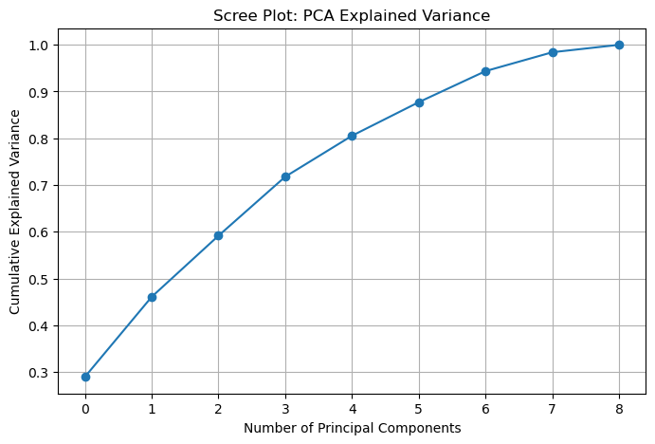
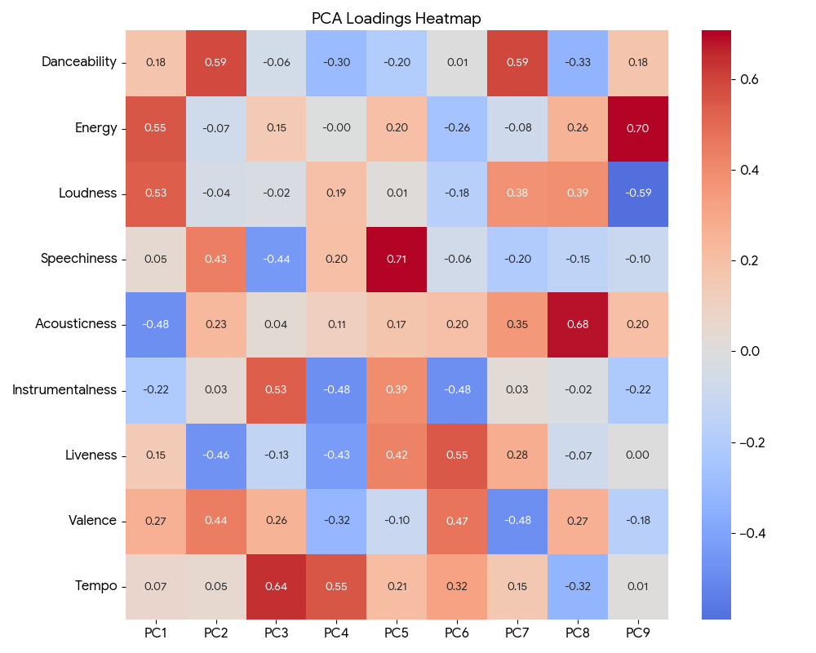
PCA Results

Slide 9


PCA Interpretation
Based on the Scree Plot and using the “70-80%” rule, I chose to use 4 components
Then we get into K-Means Clustering
Brent Faiyaz & Childish Gambino

Slide 10
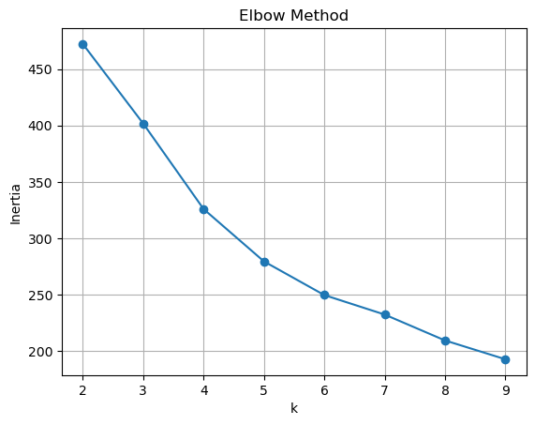
K-Means Clustering
Using the Elbow Method (graphing) and silhouette values I came to this conclusion:
Although k=2 gave the highest silhouette score, we selected k=3 to produce a more interpretable segmentation.
The silhouette score for k=3 (0.193) remained reasonable, and the 3-cluster solution created distinct and business-meaningful groups of songs.

Slide 11
Clusters
Cluster 1
Cluster 2
Cluster 3
Cluster 1 represents upbeat, mainstream pop tracks. These songs are energetic, danceable, and loud, with a positive feel. They have lower acoustic elements and slightly slower tempos, aligning with modern pop/dance production.
Cluster 2 captures acoustic, mellow, and lower-energy tracks. These songs feature softer production, higher acoustic elements, more spoken/lyrical components, and generally subdued emotional tone.
Cluster 2 represents high-tempo, high-energy tracks—often electronic, EDM, or high-BPM pop. These songs are fast, loud, and energetic with minimal acoustic elements. They tend to feel more intense and driving rather than upbeat or happy.

Slide 12



Cluster Examples
Cluster 1
Cluster 2
Cluster 3
Teenage Dirtbag
Wheatus
Hey There Delilah
Plain White T’s
Drugs N Hella Melodies
Don Tolliver & Kali Uchis

Slide 13

Conclusion
I can sleep at night knowing that there is some logic to what songs we like to listen to when we’re at the beach.
I think it follows a journey of excitement to go to the beach, relaxation and reflection, and positive vibes towards the end of a perfect day!
I think that I will continue to work on this project to continue to build a more predictive model. Stay tuned!

